Slide 1
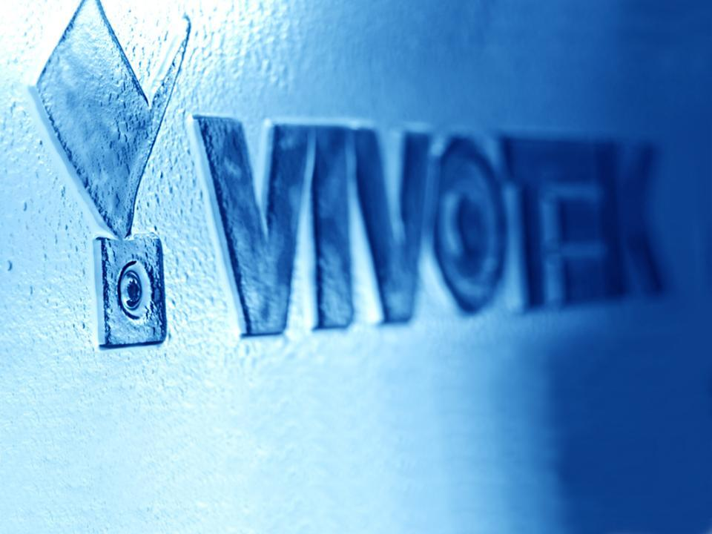
3MP Series Product Announcement
Notes:
1

Slide 2
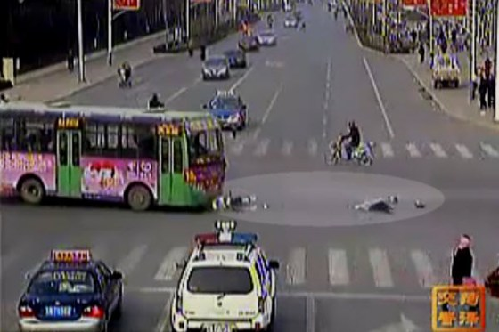
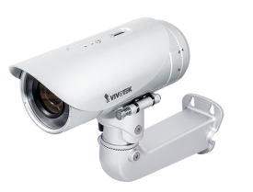
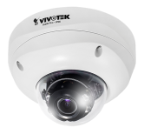
Product Position
A Series of Cameras to Provide Superb Detailed Image Quality
IP8371E
FD8371EV
FD8171
Notes:
2
A series of cameras to provide excellent image qualities with more details , which allows user to get more information or details while accidence or any criminal incidents happens .

Slide 3
Product Introduction
3-Megapixel CMOS Sensor
30 fps @ 3MP, 60 fps @ 2MP
3 ~ 9mm, Vari-focal, Remote focus, P-Iris Lens
Supreme Night Visibility
Built-in IR illuminators with Smart IR technology, effective up to 20~30 meters
Smart Stream embedded
3D Noise Reduction
Two-way Audio
Built-in 802.3af Compliant PoE
Built-in SD/SDHC/SDXC Card Slot for On-board Storage
Cable Management for Protected Installation
Notes:
3

Slide 4
Product Features & Advantages
60 fps @ 2MP
Supreme Night Visibility
Smart Stream embedded
Built-in IR illuminators with Smart IR technology, effective up to 30 meters
3D Noise Reduction
Notes:
4
We planned three phases here to implement different features on our 3mp cameras .

Slide 5
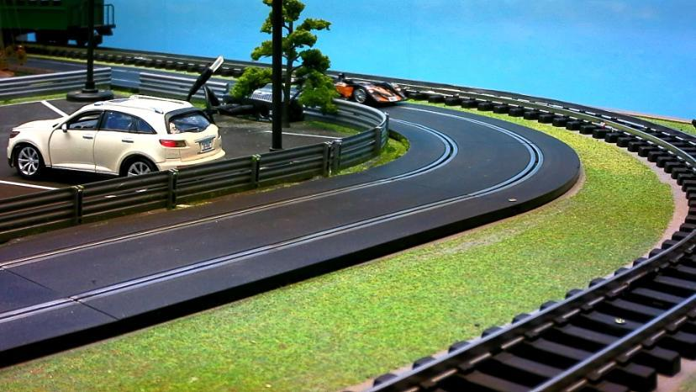
60 fps
0.00s
Shutter speed: 1/1000s
Frame rate: 60fps
Unable to recognizable License Plate
Notes:
5
Highlight Benefit of 60fps

Slide 6
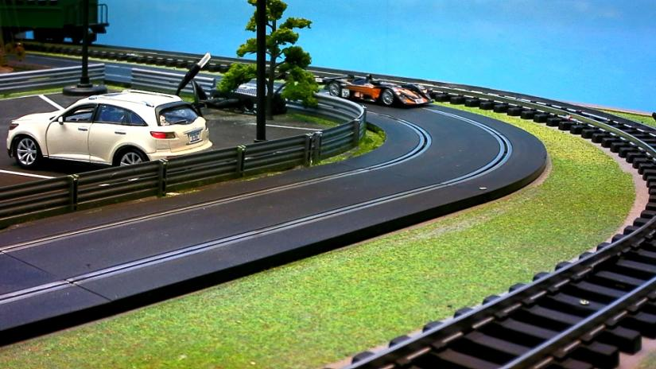
60 fps
0.01s
Shutter speed: 1/1000s
Frame rate: 60fps
Unable to recognizable License Plate
Notes:
6
Highlight Benefit of 60fps

Slide 7
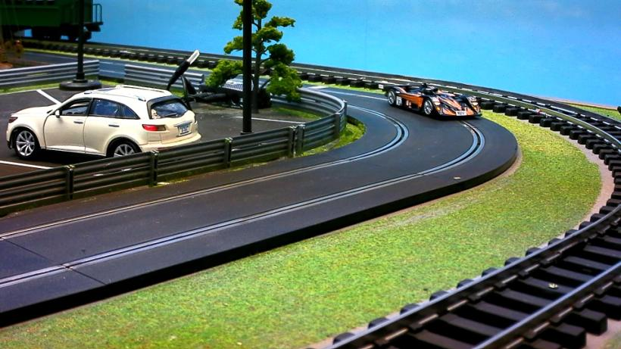
60 fps
0.03s
Shutter speed: 1/1000s
Frame rate: 60fps
Unable to recognizable License Plate
Notes:
7
Highlight Benefit of 60fps

Slide 8
60 fps
0.05s
Shutter speed: 1/1000s
Frame rate: 60fps
Able to recognizable License Plate
Notes:
8
Highlight Benefit of 60fps

Slide 9
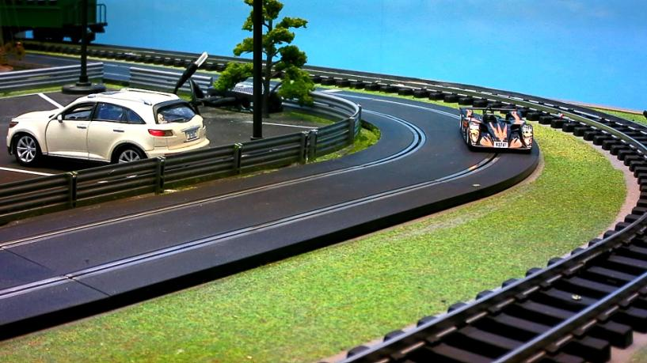
60 fps
0.06s
Shutter speed: 1/1000s
Frame rate: 60fps
Able to recognizable License Plate
Notes:
9
Highlight Benefit of 60fps

Slide 10
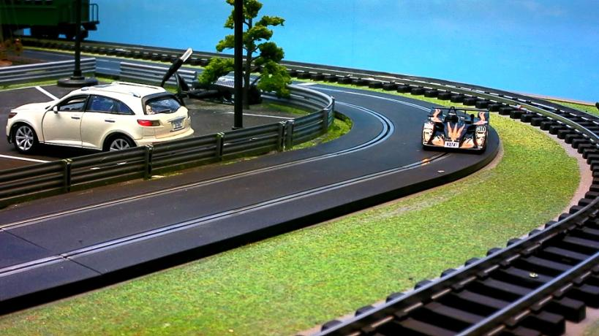
60 fps
0.08s
Shutter speed: 1/1000s
Frame rate: 60fps
Able to recognizable License Plate
Notes:
10

Slide 11
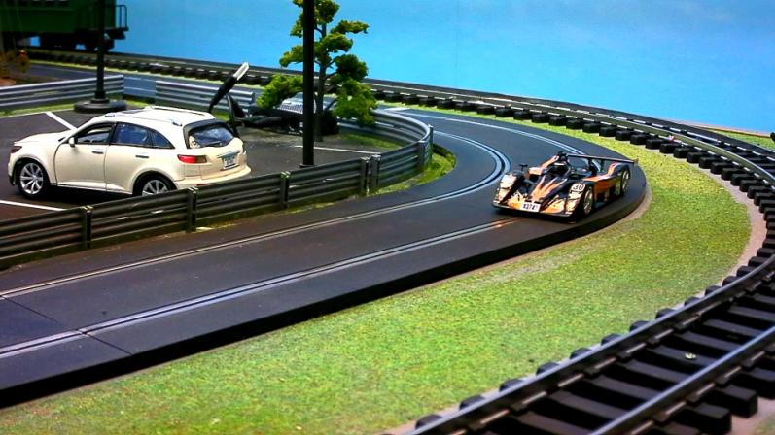
60 fps
0.10s
Shutter speed: 1/1000s
Frame rate: 60fps
Unable to recognizable License Plate
Notes:
11

Slide 12
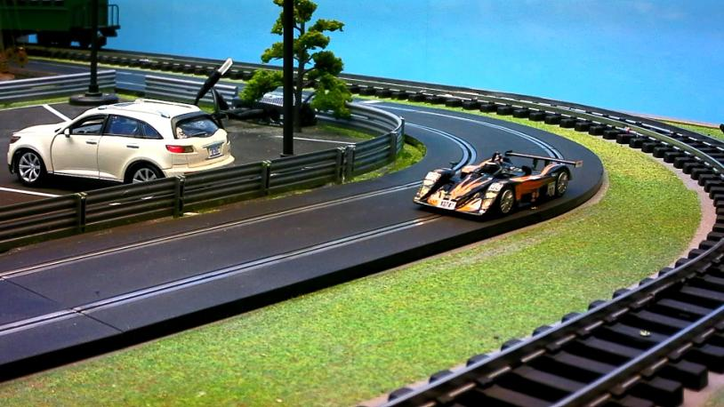
60 fps
0.11s
Shutter speed: 1/1000s
Frame rate: 60fps
Unable to recognizable License Plate
Notes:
12

Slide 13
60 fps
0.13s
Shutter speed: 1/1000s
Frame rate: 60fps
Unable to recognizable License Plate
Notes:
13

Slide 14
60 fps
0.13s
Total passing time: 0.13s
Effective frame @ 60fps: 3
Effective frame @ 30fps: 1
Shutter speed: 1/1000s
Frame rate: 60fps
Notes:
14

Slide 15
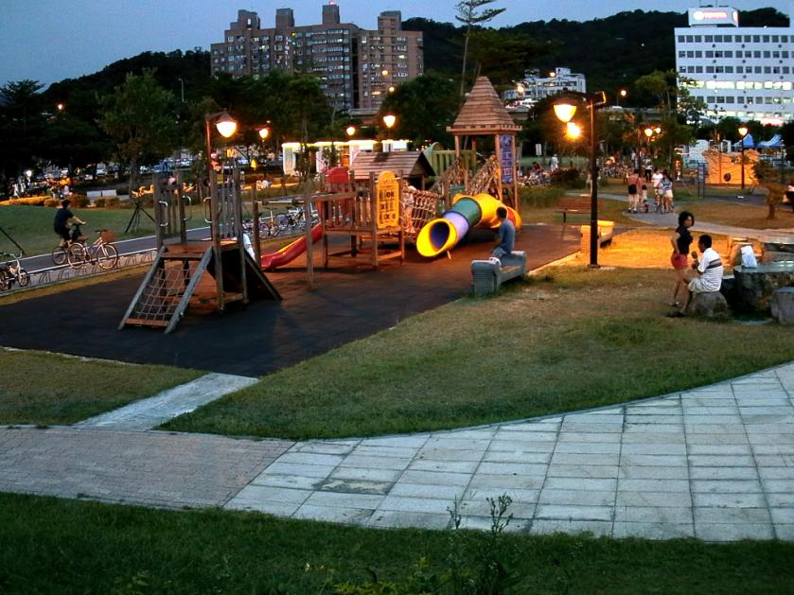
Supreme Night Visibility
3MP Performance (Daytime)
~ 100 Lux
Notes:
15
Highlight Benefit of Low Lux

Slide 16
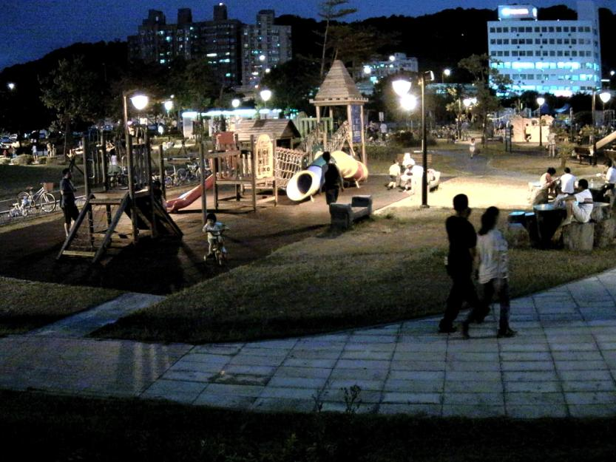
3MP Performance (Night)
3MP Performance (Night)
~ 20 Lux
Notes:
16

Slide 17
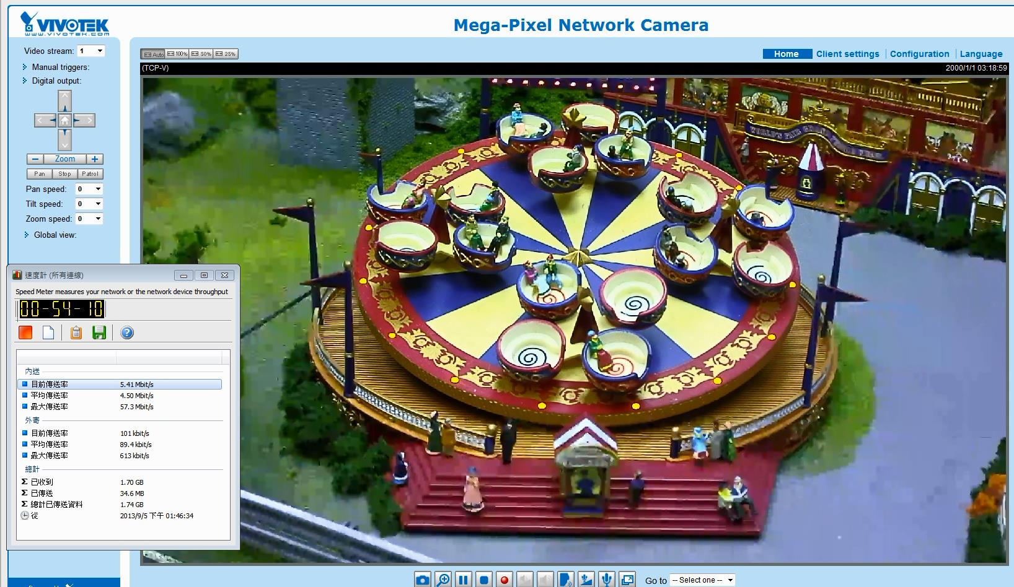
Smart Stream
Medium quality for non-active area
Excellent quality for active area
Fixed at 5Mbps
Optimizing bandwidth & storage usage!
Notes:
Highlight Benefit of smart stream
Highlight video issue and emphasize the percentage of bandwidth saved

Slide 18
Product Specification
 | IP8371E | FD8371EV | FD8171
Lens | 3~9mm Remote Focus P-Iris | 3~10mm Remote Focus P-Iris | 3~10mm Remote Focus P-Iris
Max. Frame Rate | 30fps @ 3MP 60fps @ 2MP
IR Illuminator Range | 30M Smart IR | 20M Smart IR | 20M Smart IR
Minimum Illumination | 0.02 Lux | 0.05 Lux | TBD
WDR | WDR Enhanced
DNR | 3DNR
Bandwidth saving functions | Smart Stream
Casing | IP66 | IP66, IK10 | -
Power & IO | PoE, AC24V, DC12C, Audio in/out, DI*1, DO*1, Analog out, RJ45
Operating Temperature | -50~50℃ | -50~50℃ | -30~50℃

Slide 19
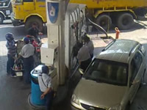
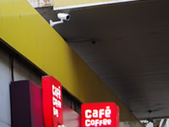
Gas Station
Value | Vehicle & customer safety Staff & assets protection Customer behavior tracking
Location | Aisles Parking Lots Shops
Features | Benefits
3-Megapixel resolution | Provide detail image for face recognition and license plate recognition.
IR Illuminators | Provide 24/7 day and night security
SD/SDHC/SDXC recording | Save bandwidth System Redundancy
UL Certificated | Fitting gas station regulation
Notes:
19

Slide 20
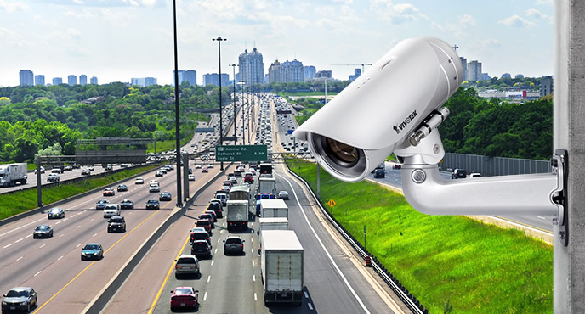
Traffic Monitoring
Value | Vehicle tracking Accident monitoring Violation monitoring
Location | Highways Crossroads
Features | Benefits
3-Megapixel resolution | Provide detail image for face recognition and license plate recognition.
60fps | Provide more details for fast moving objects
IR Illuminators | Provide 24/7 day and night security
3D Noise Reduction | Better night visibility Lower bandwidth
Notes:
20

Slide 21
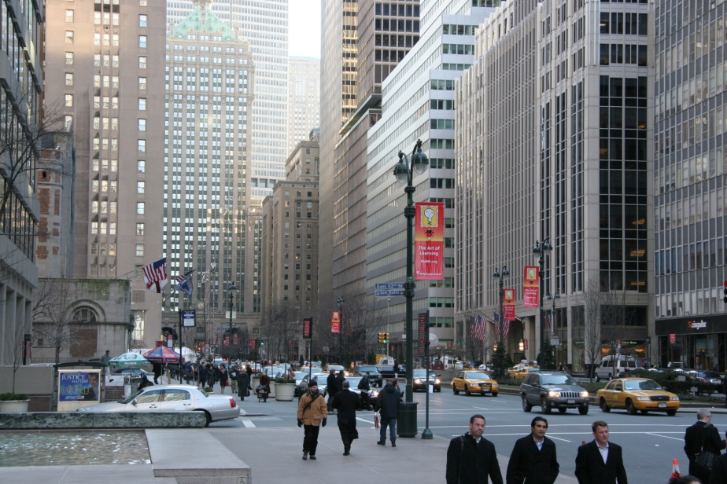
City Surveillance
Value | Citizen safety ensure Crime prevention Evidence provider
Location | Walkways Streets
Features | Benefits
3-Megapixel resolution | Provide detail image for face recognition and license plate recognition.
IR Illuminators | Provide 24/7 day and night security
Smart Stream | Object base and ROI base to provide focus with optimizing bandwidth
3D Noise Reduction | Better night visibility Lower bandwidth
SD/SDHC/SDXC recording | Save bandwidth System Redundancy
IP8371E
City Surveillance
Romania
Notes:
21

Slide 22
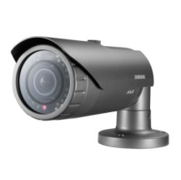
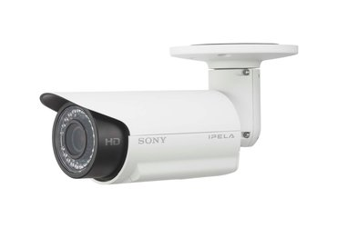
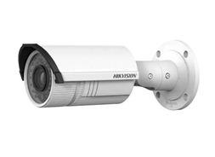
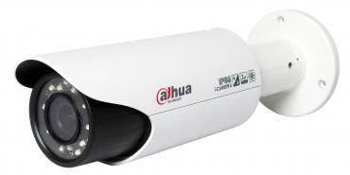
Competitor Comparison – IP8371E
 | VIVOTEK | SAMSUNG | SONY | Hikvision | Dahua
 | IP8371E | SNO7082R | SNCCH260 | DS-2CD2632F | IPC-HFW3300C
IR Illuminator Range | 30M Smart IR | 30M | 15M | 30M | 20M
Max. Frame Rate | 30fps @ 3MP 60fps @ 2MP | 20 fps @ 3MP 30 fps @ 2MP | 20fps @ 2.7MP 30fps @ 2MP | 15fps @ 3MP 30fps @ 2MP | 20fps @ 3MP 30fps @ 2MP
Minimum Illumination | 0.02 Lux | 0.01 Lux | 0.7 Lux | 0.07 Lux | 0.2 Lux
WDR | WDR Enhanced | Advanced WDR 96dB | - | Digital WDR | -
Lens | 3~9mm Remote Focus P-Iris | 3 ~ 8.5 mm Remote Focus DC-Iris | 3.1~8.9mm Remote Focus Fixed Iris | 2.8~12mm Manual Focus Fixed Iris | 3.3~12mm Manual Focus DC-Iris
DNR | 3D | 2D + 3D | Yes | 3D | 2D
Operating Temperature | -50~50℃ | -50~55℃ | -30~50℃ | -30~60℃ | -10~60℃
Bandwidth saving functions | Smart Stream | Smart Codec | - | - | -
Notes:
Check Samsung Bullet 競品分析 report

Slide 23
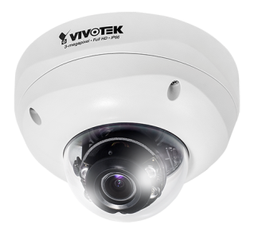
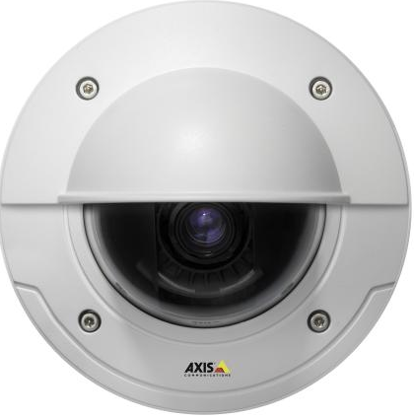
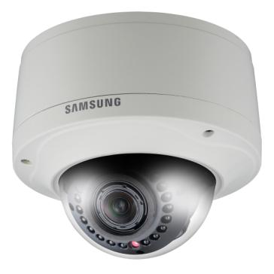
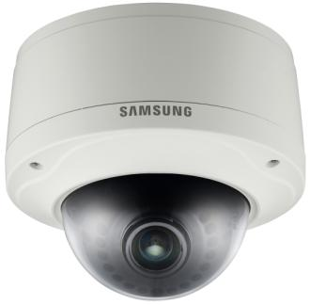
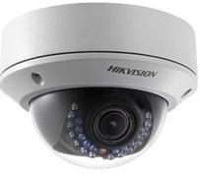
Competitor Comparison – FD8371EV
 | VIVOTEK | AXIS | Samsung |  | Hikvision
 | FD8371EV | P3346-VE | SNV-7080R | SNV-7082 | DS-2CD2732F-I(S)
IR Illuminator Range | 20M Smart IR | - | 25M | - | 20M
Max. Frame Rate | 30fps @ 3MP 60fps @ 2MP | 20fps @ 2.7MP 30fps @ 2MP | 20fps @ 2.7MP 30fps @ 2MP | 20fps @ 2.7MP 30fps @ 2MP | 15fps @ 3MP 30fps @ 2MP
Minimum Illumination | 0.05 Lux | 0.5 Lux | 1 Lux | 0.7 Lux | 0.07 Lux (AGC on)
WDR | WDR Enhanced | - | WDR@FHD (WiseNet) | Advance WDR 96dB | Digital WDR
Lens | 3~10mm Remote Focus P-Iris | 3~9mm Remote Focus P Iris | 3~8.5mm Remote Focus DC Iris | 3~8.5mm Remote Focus DC Iris | 2.8~12mm Manual Focus Fixed Iris
DNR | 3D | - | Yes | 3D | 3D
Operating Temperature | -50~50℃ | -40~50℃ | -40°C ~ +55°C | -10~55℃ | -30~60℃
Bandwidth saving functions | Smart Stream | - | - | Smart Compression | -

Slide 24
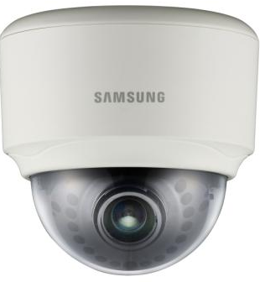
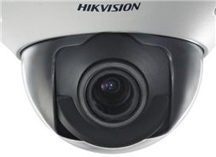
Competitor Comparison – FD8171
 | VIVOTEK | AXIS | Samsung |  | Hikvision
 | FD8171 | P3346 (Indoor) | SND-7061 (Indoor) | SND-7082 | DS-2CD7254F(WD)-E(I)Z(H)
IR Illuminator Range | 20M Smart IR | - | - | - | 30M
Max. Frame Rate | 30fps @ 3MP 60fps @ 2MP | 20fps @ 2.7MP 30fps @ 2MP | 20fps @ 2.7MP 30fps @ 2MP | 20fps @ 2.7MP 30fps @ 2MP | 15fps @ 3MP 30fps @ 2MP
Minimum Illumination | 0.05 Lux | 0.5 Lux | 0.4 Lux | 0.7 Lux | 0.1 Lux
WDR | WDR Enhanced | - | - | Advnace WDR 96dB | 120dB
Lens | 3~10mm Remote Focus P-Iris | 3~9mm Remote Focus P Iris | 3~8.5mm Remote Focus DC Iris | 3~8.5mm Remote Focus DC Iris | 2.7~9mm Manual Focus Fixed Iris
DNR | 3D | - | Yes | 3D | 3D
Operating Temperature | -20~50℃ | 0~50℃ | -10~55℃ | -10~55℃ | -25 °C ~ 60 °C -40 °C ~ 60 °C heater and fan on
Bandwidth saving functions | Smart Stream | - | Smart Compression | Smart Compression | -

Slide 25
Thank you
for your attention
The End
Notes:
25

